Slide 1
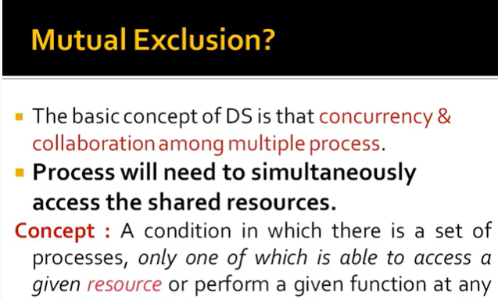
time
Mutual exclusion : makes sure that concurrent process access shared resources or data in a serialized way.
If a process , say P_{i} , is executing in its critical section, then no other processes can be executing in their critical sections
Example: updating a DB or sending control signals to an IO device

Slide 2
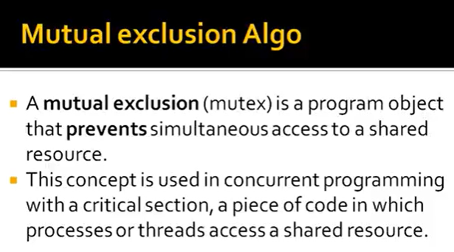

Slide 3
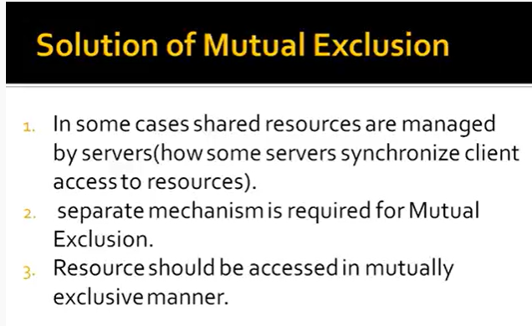

Slide 4
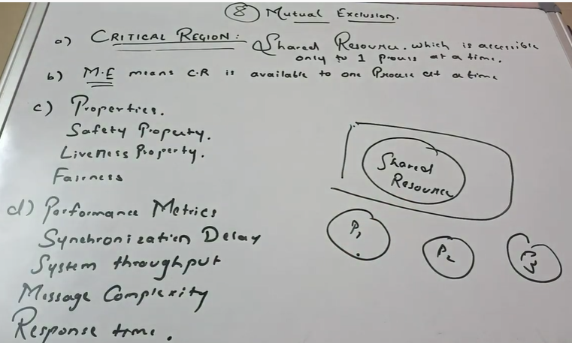

Slide 5
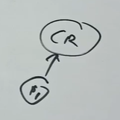
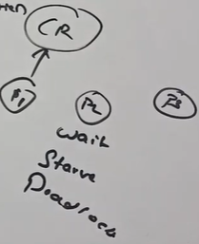
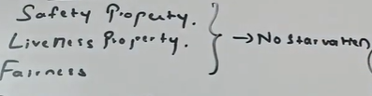
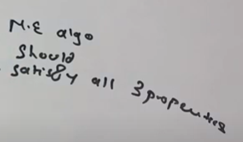
c)Properties
Safety Property: Only 1 porocess can share CR at 1 time

Slide 6
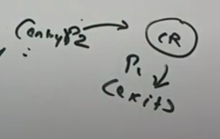
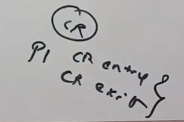
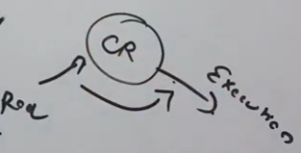
d) PerformaceMetrics:
Synchronization Delay: When 1 process exits only other process enters the CS. Ie. The time interval b/w CS exit and entry by another process.
System throughput: Rate at which CR get request message by every process to access the CS.(10 or 15 request per min.)
Message complexity: No. of messages that are required for CR execution by a process, both for entry and exit.
Response Time: time interval from a request send to CR by a process and got response from a CR to a process.

Slide 7
Mutual exclusion in DOS
There are three major communication scenarios:
1. One-way Communication usually do not need synchronization.
Client/server communication is for multiple clients making service request to a shared server. If co-ordination is required among the clients, it is handled by the server and there is no explicit interaction among client process.

Slide 8
Mutual exclusion in Distributed operating systems Contd…
3. Interprocess communication:
-> not limited to making service requests.
-> processes need to exchange information to reach some conclusion about the system or some agreement among the cooperating processes.
These activities require peer communication; there is no shared object or centralized controller.
Notes:
1. Mutual Exclusion - If process P_{i} is executing in its critical section, then no other processes can be executing in their critical sections
2. Progress - If no process is executing in its critical section and there exist some processes that wish to enter their critical section, then the selection of the processes that will enter the critical section next cannot be postponed indefinitely
3. Bounded Waiting - A bound must exist on the number of times that other processes are allowed to enter their critical sections after a process has made a request to enter its critical section and before that request is granted

Slide 9
Mutual Exclusion Algorithms
Mutual Exclusion
algorithms
Centralized
algorithms
Distributed
Algorithms
Contention Based
Algorithms
Controlled
Algorithms
(Token based algorithms)
Timestamp prioritized schemes
Tree Structure
Voting schemes
Broadcast Structure
Ring Structure

Slide 10
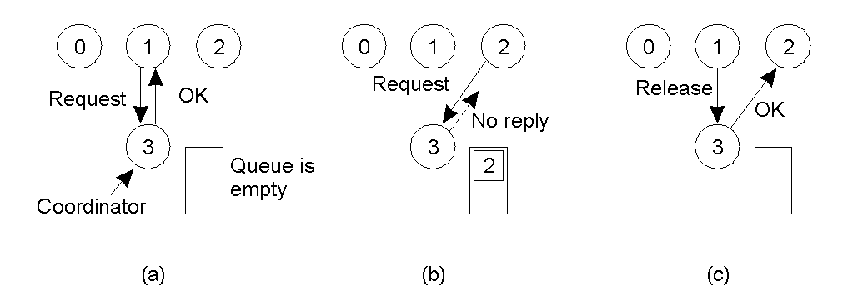
Centralized Algorithm
Ensure that CR must be accessed by the process that require and must achieve mutual exclusion. Among several process, elect 1 process as a coordinator using election algo. This coordinator will allow each requesting process to access CR and also ensure that ME must be fulfilled. This algo is based on 3 messages: request, response, release
a) . Process 1 asks the coordinator for permission to enter a critical region. Permission is granted
b) . Process 2 then asks permission to enter the same critical region. The coordinator does not reply.
c) . When process 1 exits the critical region, it tells the coordinator, which then replies to 2

Slide 11
Centralized algorithms contd..
Advantages
  Fair algorithm, grants in the order of requests
  The scheme is easy to implement
  Scheme can be used for general resource allocation
  Critical Question: When there is no reply, does this mean that the coordinator is “dead” or just busy?
Shortcomings
  Single point of failure. No fault tolerance
  Confusion between No-reply and permission denied
  Performance bottleneck of single coordinator in a large system

Slide 12
Distributed Algorithms
Distributed Mutual Exclusion
  Contention-based Mutual Exclusion
    Timestamp Prioritized Schemes
    Voting Schemes
  Token-based Mutual Exclusion
    Ring Structure
    Tree Structure
    Broadcast Structure

Slide 13
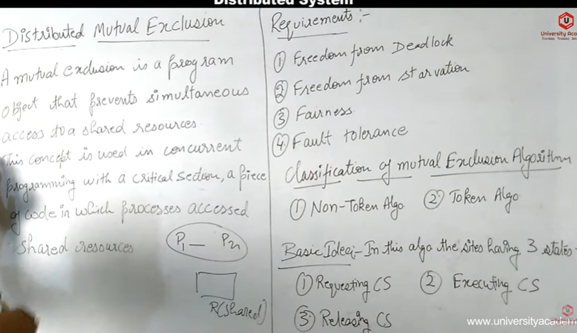

Slide 14
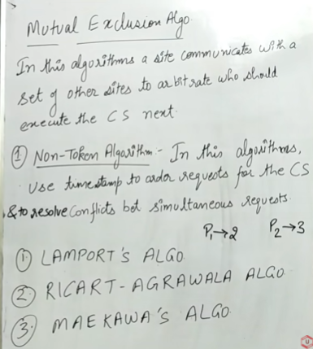

Slide 15
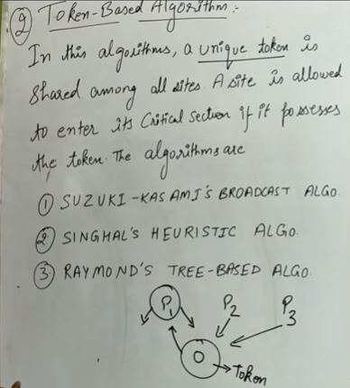

Slide 16
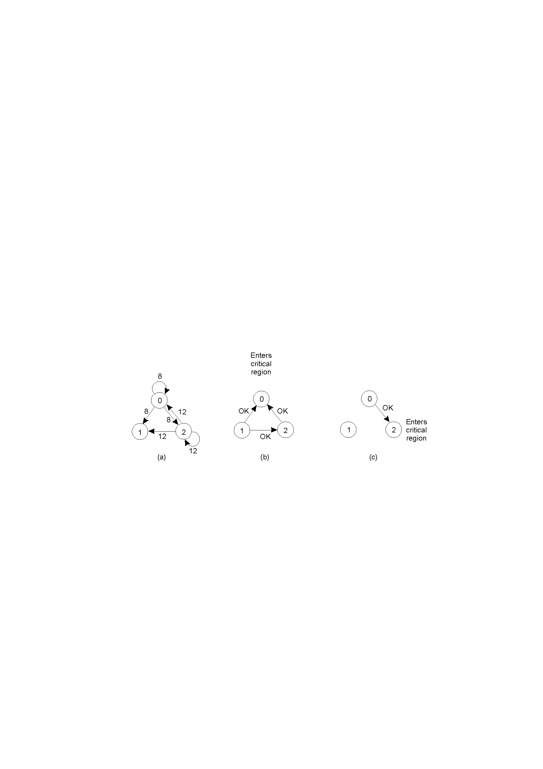
1- Lamport’s Distributed Mutual Exclusion Algorithm (Non-Token)
Timestamp is used to order critical section requests and to resolve any conflict between requests.
In Lamport’s Algorithm critical section requests are executed in the increasing order of timestamps i.e a request with smaller timestamp will be given permission to execute critical section first than a request with larger timestamp.
A> Two processes want to enter the same critical region .
B> Process 0 has the lowest timestamp, so it wins.
C> When process 0 is done, it sends an OK also, so 2 can now enter the critical region

Slide 17
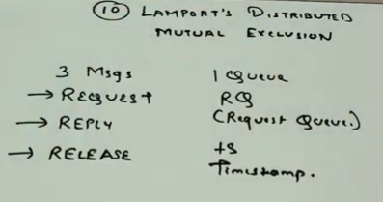
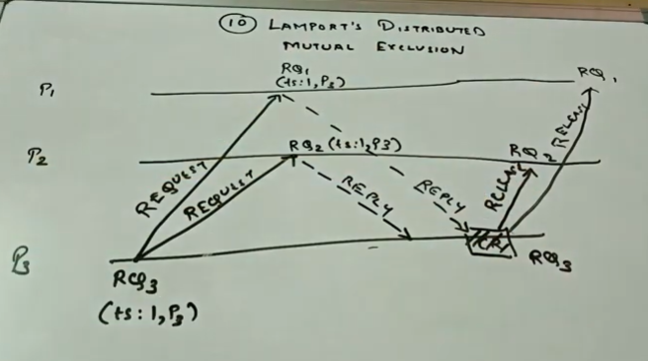
Ex: When 1 process request for CR

Slide 18
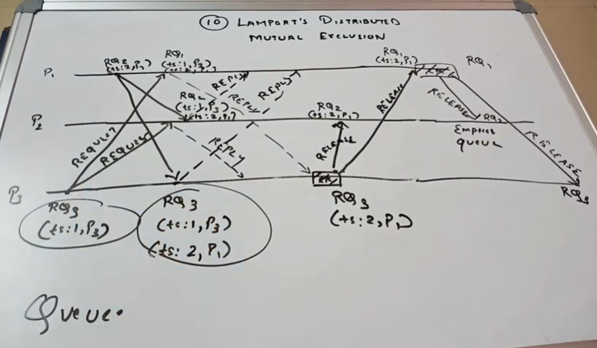
Cont… Lamport : Ex: When 2 process request for CR
Queue has a significant role here.

Slide 19
In this algorithm:
Three type of messages ( REQUEST, REPLY and RELEASE) are used and communication channels are assumed to follow FIFO order.
A site send a REQUEST message to all other site to get their permission to enter critical section.
A site send a REPLY message to requesting site to give its permission to enter the critical section.
A site send a RELEASE message to all other site upon exiting the critical section.
Every site S_{i}, keeps a queue to store critical section requests ordered by their timestamps.
request_queue_{i} denotes the queue of site S_{i}
A timestamp is given to each critical section request using Lamport’s logical clock.
Timestamp is used to determine priority of critical section requests. Smaller timestamp gets high priority over larger timestamp. The execution of critical section request is always in the order of their timestamp.

Slide 20
Algorithm:
To enter Critical section:
  When a site S_{i} wants to enter the critical section, it sends a request message Request(ts_{i}, i) to all other sites and places the request on request_queue_{i}. Here, Ts_{i} denotes the timestamp of Site S_{i}
  When a site S_{j} receives the request message REQUEST(ts_{i}, i) from site S_{i}, it returns a timestamped REPLY message to site S_{i} and places the request of site S_{i} on request_queue_{j}
  .
To execute the critical section:
  A site S_{i} can enter the critical section if it has received the message with timestamp larger than (ts_{i}, i) from all other sites and its own request is at the top of request_queue_{i}
To release the critical section:
  When a site S_{i} exits the critical section, it removes its own request from the top of its request queue and sends a timestamped RELEASE message to all other sites
  When a site S_{j} receives the timestamped RELEASE message from site S_{i}, it removes the request of S_{i} from its request queue

Slide 21
Message Complexity:
Lamport’s Algorithm requires invocation of 3(N – 1) messages per critical section execution. These 3(N – 1) messages involves
(N – 1) request messages
(N – 1) reply messages
(N – 1) release messages
Drawbacks of Lamport’s Algorithm:
Unreliable approach: failure of any one of the processes will halt the progress of entire system.
High message complexity: Algorithm requires 3(N-1) messages per critical section invocation.
Performance:
Synchronization delay is equal to maximum message transmission time
It requires 3(N – 1) messages per CS execution.
Throughput:
CS requests handled per time unit = 1 / (T + E) where E is average execution time of CS,
T, is Synchronization delay

Slide 22
2. Ricart–Agrawala Algorithm in Mutual Exclusion
Ricart–Agrawala algorithm is an algorithm to for mutual exclusion in a distributed system proposed by Glenn Ricart and Ashok Agrawala. This algorithm is an extension and optimization of Lamport’s Distributed Mutual Exclusion Algorithm. Like Lamport’s Algorithm, it also follows permission based approach to ensure mutual exclusion.
In this algorithm:
Two type of messages ( REQUEST and REPLY) are used and communication channels are assumed to follow FIFO order.
A site send a REQUEST message to all other site to get their permission to enter critical section.
A site send a REPLY message to other site to give its permission to enter the critical section.
A timestamp is given to each critical section request using Lamport’s logical clock.
Timestamp is used to determine priority of critical section requests. Smaller timestamp gets high priority over larger timestamp. The execution of critical section request is always in the order of their timestamp.

Slide 23
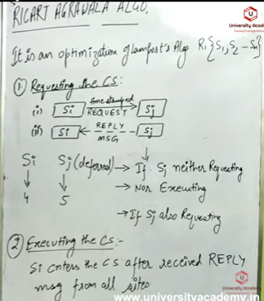
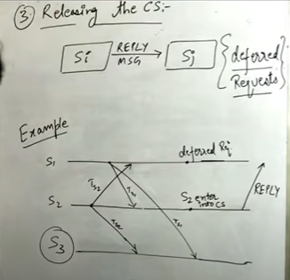

Slide 24
Algorithm:
To enter Critical section:
  When a site S_{i} wants to enter the critical section, it send a timestamped REQUEST message to all other sites.
  When a site S_{j} receives a REQUEST message from site S_{i}, It sends a REPLY message to site S_{i} if and only if
    Site S_{j} is neither requesting nor currently executing the critical section.
    In case Site S_{j} is requesting, the timestamp of Site S_{i}‘s request is smaller than its own request. Otherwise the request is deferred by site S_{j}.
To execute the critical section:
  Site S_{i} enters the critical section if it has received the REPLY message from all other sites.
To release the critical section:
  Upon exiting site S_{i} sends REPLY message to all the deferred requests.
Message Complexity:
Ricart–Agrawala algorithm requires invocation of 2(N – 1) messages per critical section execution. These 2(N – 1) messages involves
(N – 1) request messages
(N – 1) reply messages

Slide 25
Drawbacks of Ricart–Agrawala algorithm:
Unreliable approach: failure of any one of node in the system can halt the progress of the system. In this situation, the process will starve forever.
The problem of failure of node can be solved by detecting failure after some timeout.
Performance:
Synchronization delay is equal to maximum message transmission time
It requires 2(N – 1) messages per Critical section execution

Slide 26
3-Voting schemes
Requestor:
Send a request to all other processes.
Enter critical section once REPLY from a majority is received
Broadcast RELEASE upon exit from the critical section.
Other processes:
REPLY to a request if no REPLY has been sent. Otherwise, hold the request in a queue.
If a REPLY has been sent, do not send another REPLY till the RELEASE is received.
Possibility of a Deadlock
Consider a situation when each candidate wins one-third of votes…..
Voting scheme ,improvement
One of the possible solutions would be :
Any process retrieves its REPLY message by sending an INQUIRY if the requestor is not currently executing in the critical section. The Requestor has to return the vote through a RELINQUISH message.
One of the possible solutions would be :
Any process retrieves its REPLY message by sending an INQUIRY if the requestor is not currently executing in the critical section. The Requestor has to return the vote through a RELINQUISH message.

Slide 27
3-1: Maekawa’s Algorithm
It is quorum based approach to ensure mutual exclusion in distributed systems. As we know, In permission based algorithms like Lamport’s Algorithm, Ricart-Agrawala Algorithm etc. a site request permission from every other site but in quorum based approach, A site does not request permission from every other site but from a subset of sites which is called quorum.
In this algorithm:
Three type of messages ( REQUEST, REPLY and RELEASE) are used.
A site send a REQUEST message to all other site in its request set or quorum to get their permission to enter critical section.
A site send a REPLY message to requesting site to give its permission to enter the critical section.
A site send a RELEASE message to all other site in its request set or quorum upon exiting the critical section.

Slide 28
The construction of request set or Quorum:
A request set or Quorum in Maekawa’s algorithm must satisfy the following properties:
1. ∀i ∀j : i ≠ j, 1 ≤ i, j ≤ N :: Ri ⋂ Rj ≠ ∅
i.e there is at least one common site between the request sets of any two sites.
2. ∀i : 1 ≤ i ≤ N :: Si ∊ Ri
3. ∀i : 1 ≤ i ≤ N :: |Ri| = K
4. Any site Si is contained in exactly K sets.
5. N = K(K - 1) +1 and |Ri| = √N

Slide 29
Algorithm:
To enter Critical section:
  When a site S_{i} wants to enter the critical section, it sends a request message REQUEST(i) to all other sites in the request set R_{i}.
  When a site S_{j} receives the request message REQUEST(i) from site S_{i}, it returns a REPLY message to site S_{i} if it has not sent a REPLY message to the site from the time it received the last RELEASE message. Otherwise, it queues up the request.
To execute the critical section:
  A site S_{i} can enter the critical section if it has received the REPLY message from all the site in request set R_{i}
To release the critical section:
  When a site S_{i} exits the critical section, it sends RELEASE(i) message to all other sites in request set R_{i}
  When a site S_{j} receives the RELEASE(i) message from site S_{i}, it send REPLY message to the next site waiting in the queue and deletes that entry from the queue
  In case queue is empty, site S_{j} update its status to show that it has not sent any REPLY message since the receipt of the last RELEASE message

Slide 30
Message Complexity:
Maekawa’s Algorithm requires invocation of 3√N messages per critical section execution as the size of a request set is √N. These 3√N messages involves.
√N request messages
√N reply messages
√N release messages
Drawbacks of Maekawa’s Algorithm:
This algorithm is deadlock prone because a site is exclusively locked by other sites and requests are not prioritized by their timestamp.
Performance:
Synchronization delay is equal to twice the message propagation delay time
It requires 3√n messages per critical section execution.

